Slide 1
CANNABIS
DECEMBER 2020
CANORGANICS

Slide 2
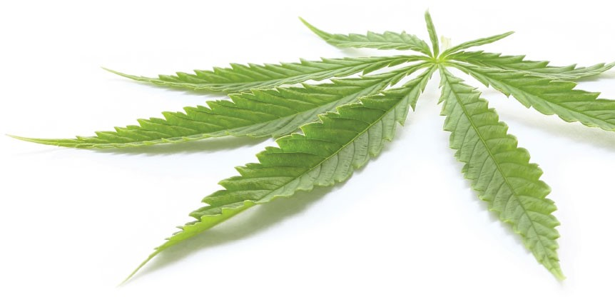
INTRODUCTION
The hemp and cannabis industry has seen tremendous growth in the past years with the legalization of recreational cannabis in Canada and hemp in the USA.
The industry is projected to surpass $146.4 billion by 2025, according to Grand View Research, driven by the liberalization of cannabis regulations around the world.
While most of this growth has come from cannabis flower, there's no doubt that hemp derived CBD tinctures, edibles and topicals are the fastest growing subset of the market. And, topicals could become the fastest growing subset of that CBD derivatives market in short order as it generates better demand and margins than dried flower.
CBD derivative products contain very little active ingredient, though pricing and margins actually increase significantly compared to dried flower, if compared on an equivalent basis. CBD to delta 8 THC conversion is disrupting cannabis flower market with its low cost of hemp production to cannabis.
All eyes remain on Mexico as it prepares for the hemp and cannabis legalization, a step that will keep the country firmly at the vanguard of a societal revolution and a new industry exploding with potential.
CanOrganics, with 32,000SF plant and cultivation located in the heart of Canada’s hemp growing region and subsidiary at Mexican border in Belize, is strategically located to capitalize on this opportunity.
We are building strong business fundamentals as the regulatory and business environment settles, with patience, perseverance and confidence—along with a well-developed business strategy backed up by proven team and partners, know how and patents.
1

Slide 3

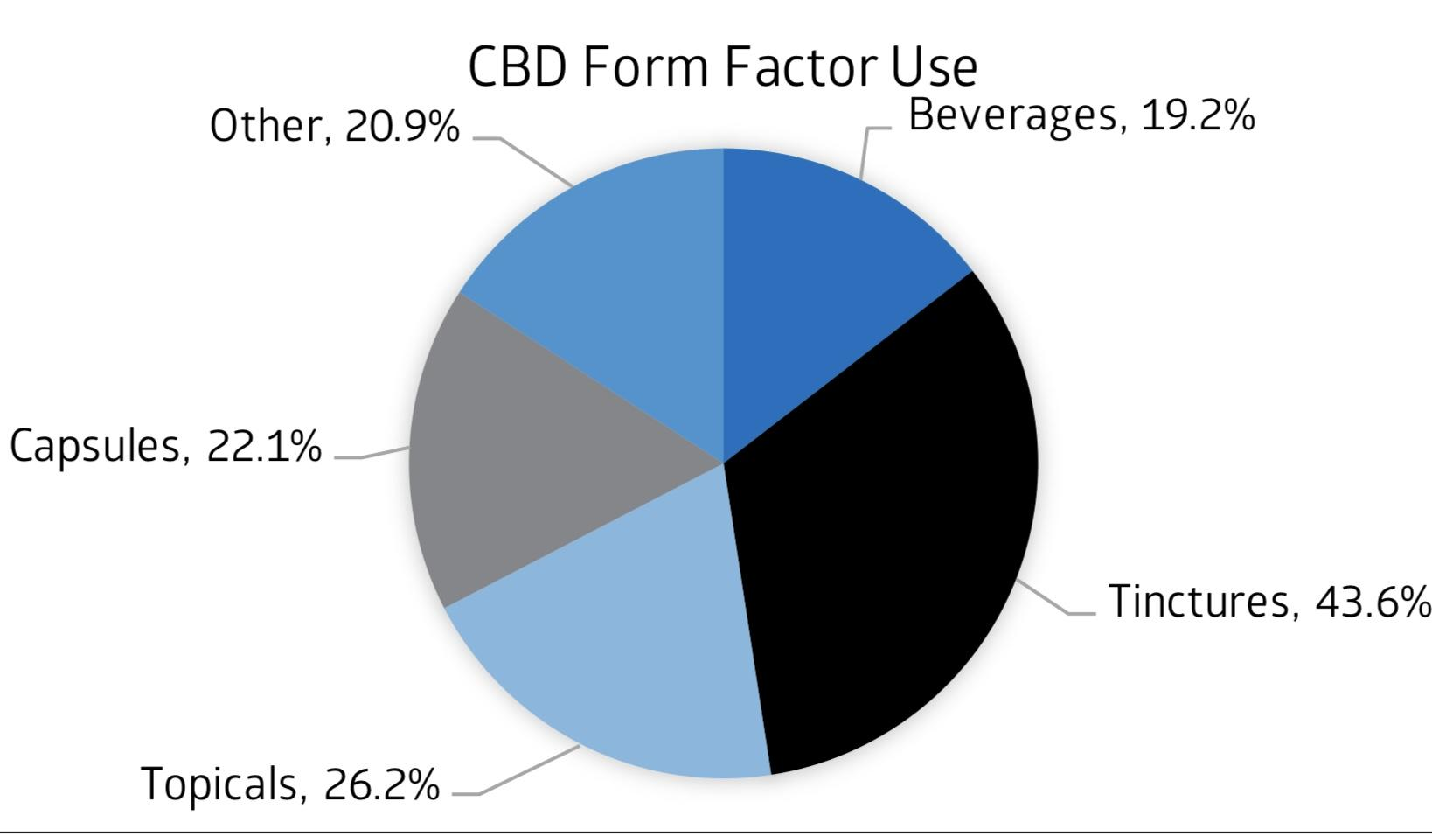
MARKET OPPORTINUTY
Hemp derived cannabinoids account for the major share of the CBD market versus marijuana derived CBD products. According to cannabis research firm Brightfield Group, the hemp derived CBD market in the United States will total more than $11 billion by 2020 and top $21 by 2022.
According to Marijuana Business Magazine CBD is driving growth across the cannabis industry and giving companies opportunities that never existed in marijuana.
Nearly 7 percent of Americans are already using cannabidiol (CBD), placing the potential market opportunity for the much-hyped cannabis compound at $16 billion by 2025, according to a new analysis by Cowen & Co.
The Cowen survey found that CBD use is highest among consumers aged 18 to 34. Tinctures (liquid extracts) accounted for the biggest chunk of the market at 44 per cent, followed by topicals at 26 per cent, capsules at 22 per cent and beverages at 19 per cent.
With hemp and cannabis legalization in Mexico, extracted products could represent 50 percent of the market.
2

Slide 4
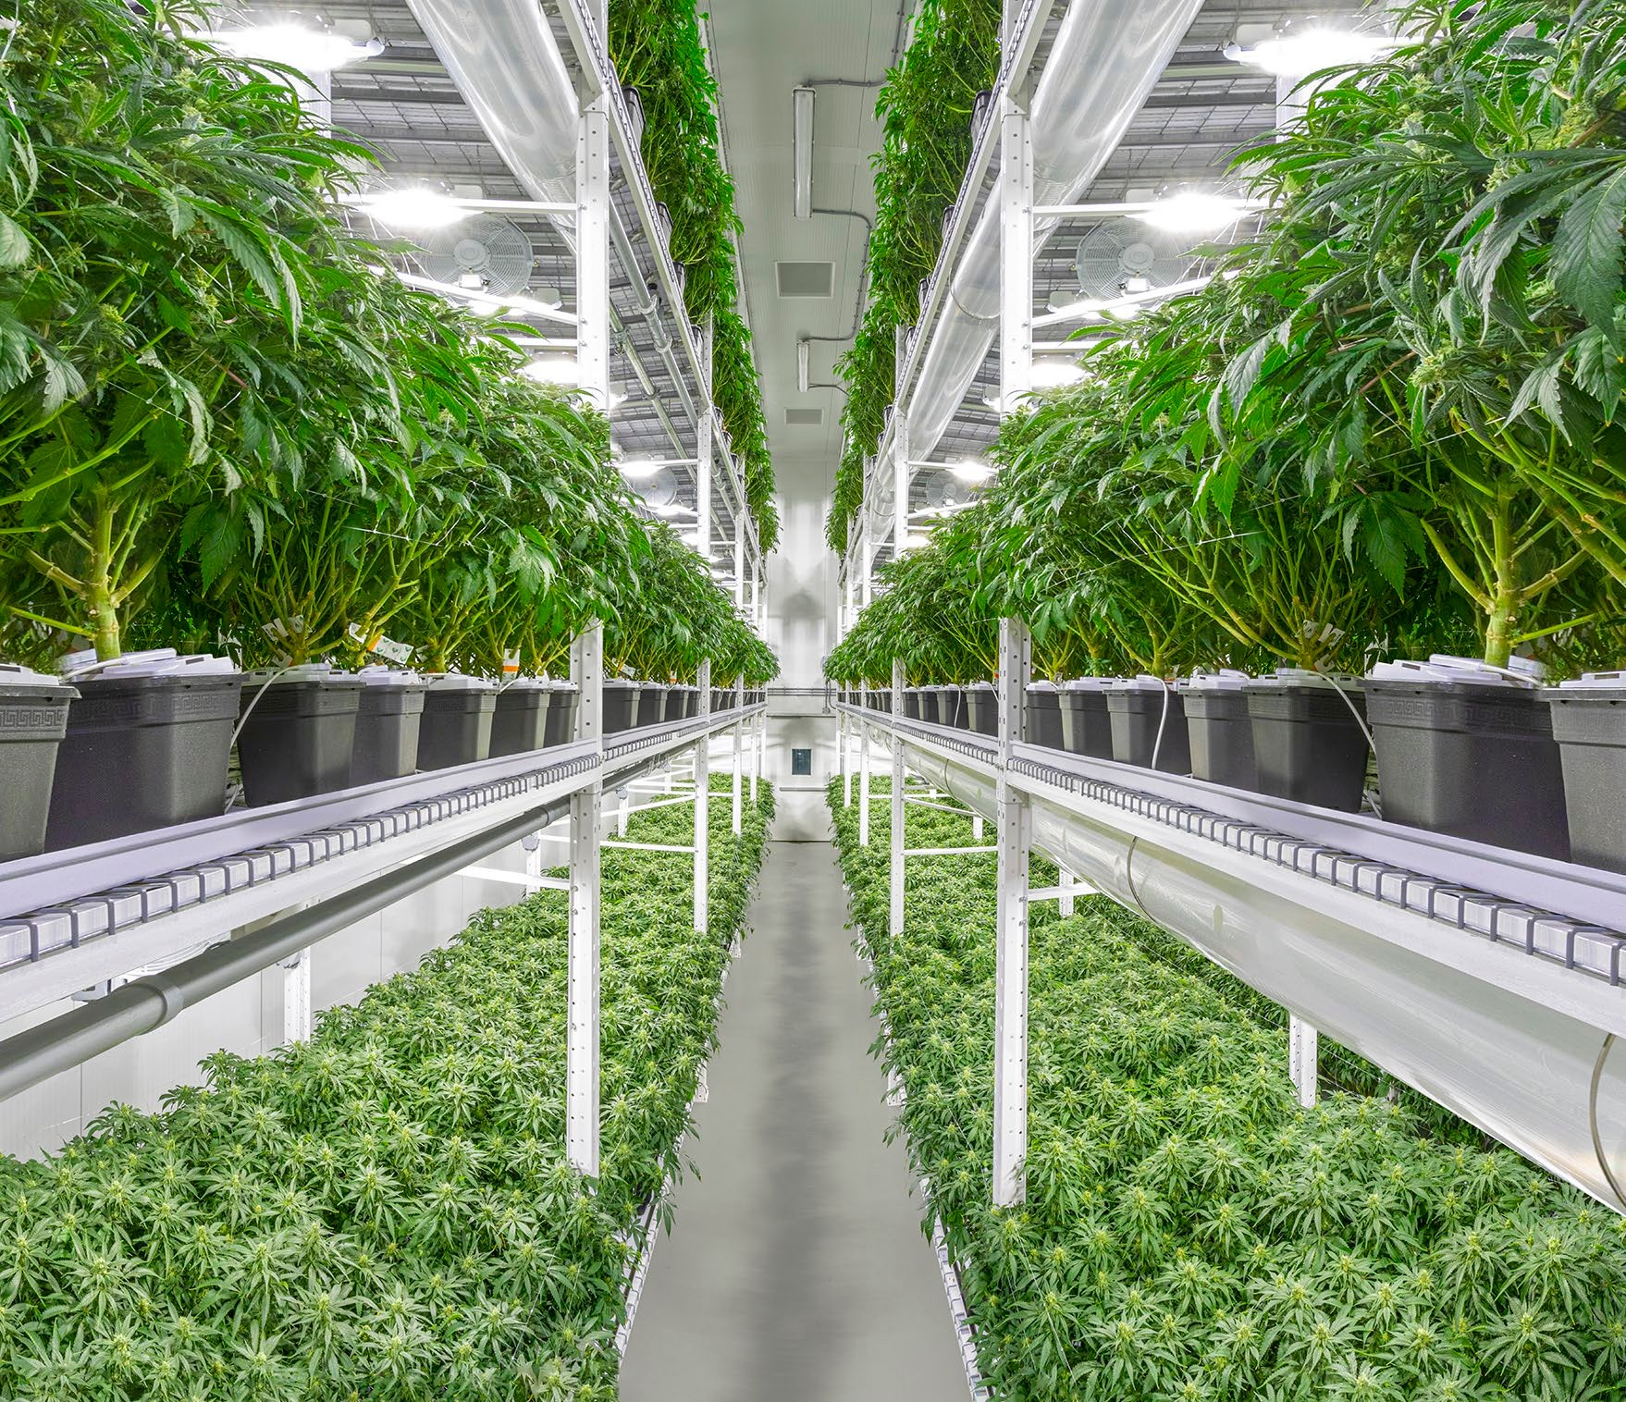
CANADIAN OPERATIONS
2018 Canada legalized recreational cannabis
2019 CanOrganics received hemp processors license
2020 CanOrganics received cannabis processors license
2021 CanOrganics will receive store, online sales and home delivery license
32,000SF plant in Swift Current, SK
14,000SF biomass drying and secure storage
Indoor, outdoor and greenhouse cultivation
Ethanol extraction of CBD
CBD processing in to Delta 8 THC
Consumer packaged goods formulation
30 million bottles per year packaging capacity
Beverages, tinctures and topicals
3

Slide 5
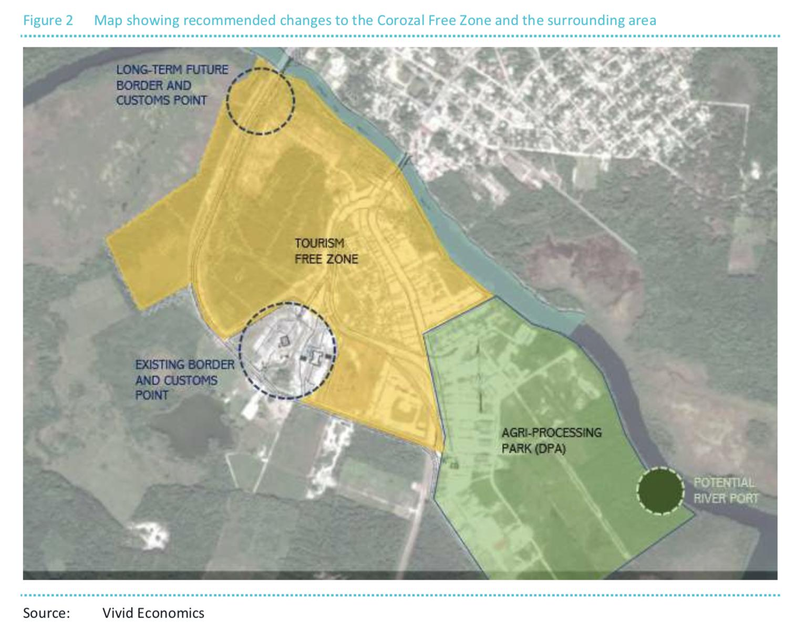
BELIZE OPERATIONS - MEXICO
We are building a vertically integrated operation with cultivation, extraction, processing and packaging at the border with Mexico in Belize.
Belize has free trade agreements with Canada and EU, and preferential with USA.
CanOrganics is working on a facility within Free Zone Agri Processing Park.
Our first complete vertical integration in Belize will ensure the highest quality control for all of our hemp CBD products and over 90% margins and the ability to compete well into the future.
We have the team in place to successfully run an efficient processing facility.
In addition, tax incentives with no income, sales and capital gain tax is a tax haven for investors.
Belize government was advised to re-purpose half of the Corozal Free Zone (CFZ) to Agri Processing Park to facilitate regional economic development in the Corozal District.
CanOrganics Organics is welcomed to Free Zone as the only party to set up agri processing and extraction operation.
5

Slide 6
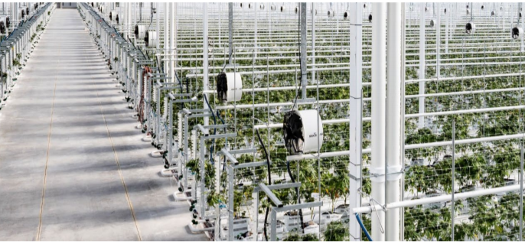
BELIZE CULTIVATION
CanOrganics established Xaman Organics in Northern Belize to cultivate 1 percent THC hemp and extract cannabinoids, process and package derivative products at Free Zone located at the border with Mexico.
Countries favourable climate is allowing for 3-4 hemp harvests per year.
Irrigated clean land at $700 per acre and labour at $1.65 are one of the lowest costs in the world.
CanOrganics tapped into infrastructure of former American company Fruta Bomba which cultivated papayas for over 20 years on over 1,000 acres employing 1,700 people.
Xaman Organics leased Fruta Bomba’s 5 acre security fenced nursery and employing their key people, and developed Good Agriculture and Collection Practices.
Greenhouse and outdoor cultivation on prepared and irrigated land
Access to additional more than 1,000 irrigated acres
In-house feminized seed and seedling production in our recently constructed nursery
Convenient and short road access between farmland and Free Zone extraction and processing facility
6

Slide 7
PROVEN TEAM
Jerónimo Ulloa - PLANT MANAGER
Assistant Professor at Pharmacognosy Department, Faculty of Exact and Natural Sciences, Universidad de Belgrano, Buenos Aires, Argentina; in charge of both theoretical and practical lectures for pharmacy students. Design and implementation of practical activities. Jerónimo is also managing both technical and administrative issues at “La Nueva Jagüel” Pharmacy according to local laws. Dispensation of medication, contact with and payment to suppliers, management of required documentation, medication storage control.
He is a researcher at Pharmacognosy Department, Pharmacy and Biochemistry Faculty, UBA, Argentina in charge of extraction, purification and isolation of plant natural compounds (column chromatography, liquid-liquid extraction, TLC, HPTLC, HPLC, bioassay guided fractionation, lyophilization, rotary evaporation, etc.). Evaluation of the biological activity (antitumor, cytotoxic, anti-parasitic, antioxidant) of extracts, purified fractions and pure compounds. Notions on spectroscopic structure elucidation. Quality control of herbal medicines, dietary supplements and phytotherapeutics. Detection of adulterants. Development and validation of analytical techniques for herbal raw materials and products.
Previously, he worked as R&D analyst at Gador SA and Sandoz Novartis Division.
Gilberto Vivas - CULTIVATION MANAGER
The best candidate for our lead cultivator isn’t someone who learned to grow marijuana in the backyard or basement, but someone with a strong background in cultivating other crops can apply that expertise and similar techniques to hemp.
Our veteran lead cultivator creates and implements policies and standard operating procedures, identifies, investigates, or resolves security breaches. maintains plant inventory and supplies.
8

Slide 8
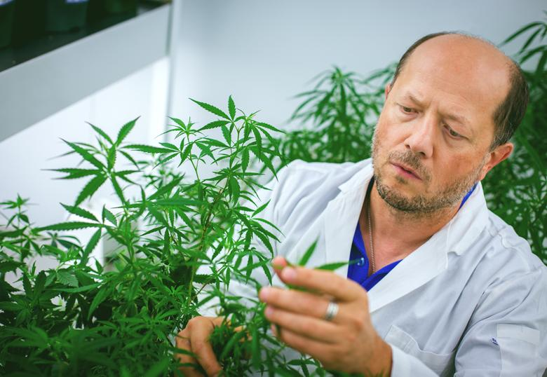
CANADIAN PARTNERS – INPLANTA BIOTECHNOLOGY
InPlanta Biotechnology is a plant research and development company that utilizes both basic and applied scientific approaches to studying cannabis and other medical plants.
The company’s principal, Igor Kovalchuk, is a professor of plant biotechnology at University of Lethbridge with 25 years of experience working with plants and published over 150 peer-reviewed articles in plant biology.
He has over 20 patents in plants including wheat, canola, tobacco, poppy and cannabis.
CanOrganics licensed his patent on conversion of CBD in to delta 8 THC.
https://patents.google.com/patent/US20200262806A1/en
9

Slide 9
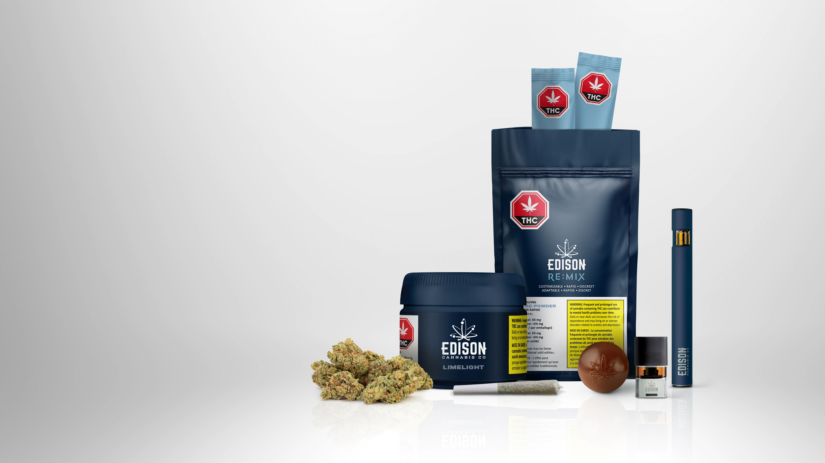
EXTRACTION PROCESS
Traditionally, smoking cannabis products has been the primary form of consumption, followed by crudely extracted oils using cooking type oils to produce infused edibles for those that do not wish to or are restricted from smoking.
Over the past five years extraction and distillation equipment and methodologies have become more sophisticated as producers turn from essential oil extractions to hemp and cannabis.
Extracting the cannabinoids (chemicals that activate cannabinoid receptors in the body) and other essential compounds and oils from hemp and cannabis is a difficult and expensive process.
Once the dried hemp or cannabis has been milled, it moves on to the extraction system.
Chilled ethanol is typically used in alcohol extractions whereby the plant matter is soaked and centrifuged in the solvent until sufficient cannabinoids and terpenes have been removed.
In excess of 90% of the ethanol solvent can be recovered and reused following an extraction run, reducing this method’s operating costs.
13

Slide 10
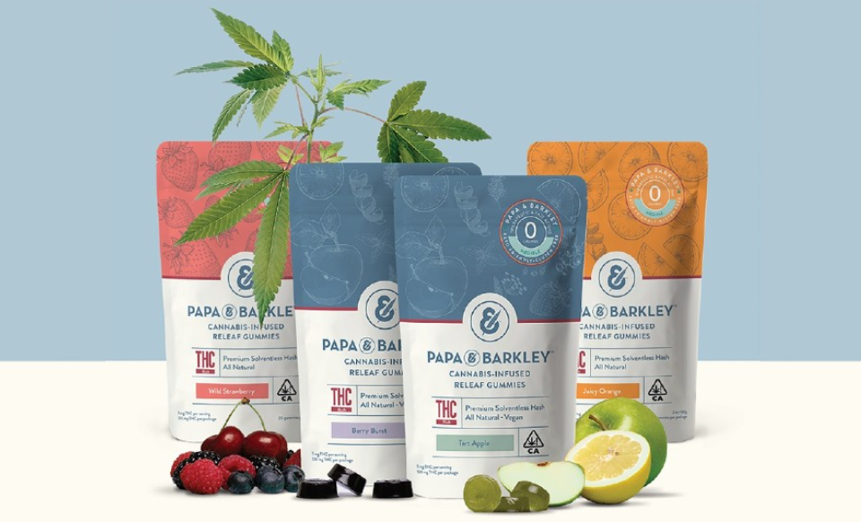
TOPICAL PRODUCTS
Processing and Packaging
Monthly Production Capacity:
200,000 topical products 1 gram CBD
Tincture | Shampoo
Cleansing cream | Conditioner
Shower gel | After sun
Body lotion | Hand cream
Eye cream | Öl-gel intim
Face serum | Foot cream
17

Slide 11
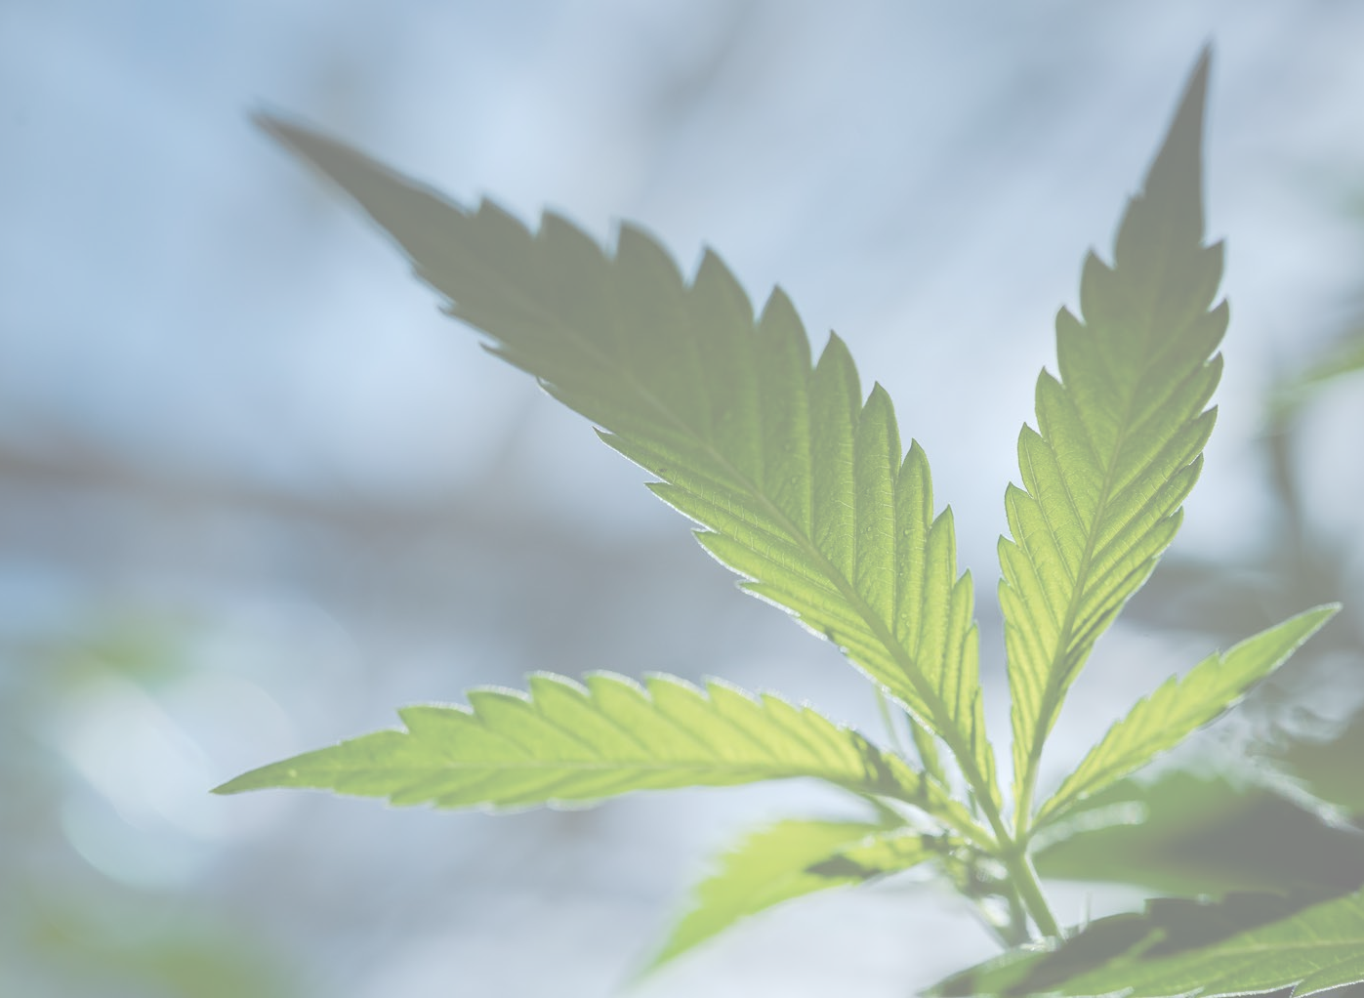
THANK YOU

